Slide 1
Welcome to Your Benefits Open Enrollment!
Insert Client Logo
Notes:
Welcome to your Benefits Open Enrollment period. This presentation will provide an overview of the benefits available to you and your family.

Slide 2
WELCOME TO OPEN ENROLLMENT
Carolina Therapy Services offers you a competitive and rewarding benefits package. We are proud to offer you benefits designed to protect the health and financial security of you and your family.
Open Enrollment is May 15, 2019 to May 21, 2019 at 1PM.
Elections made during open enrollment will become effective June 1, 2019.
Medical & Rx
Dental
Vision
Basic Life
Short & Long Term Disability
Teladoc
Flexible Spending Account
Critical Illness
Notes:
Open Enrollment gives you the opportunity to enroll in benefits focused on your health and wellbeing.
Your benefits represent a significant portion of your total compensation. So, we want to ensure that you understand your benefit options so that you can choose the best plans for you.
This presentation will provide an overview of each plan offered this year.

Slide 3
BENEFITS ELIGIBILITY
If you are a full-time employee – working 30 or more hours per week – you are eligible to enroll in the benefits described in this presentation.
New hires become eligible for benefits on the 1st of the month following 30 days of employment
The following family members are eligible for Medical, Dental, and Vision plans.
- Legal Spouse and dependent children under 26
Notes:
If you are a full-time employee, you are eligible to enroll in the benefits described in this presentation.
You will also have the option of enrolling your dependents for certain plans. Remember you will need your dependent’s date of birth and social security number on hand to enroll them.

Slide 4
OPEN ENROLLMENT CHECKLIST
Review your current benefit elections
Verify your personal information and make changes, if necessary
Evaluate plan options and make your benefit elections
Notes:
During Open Enrollment, we recommend reviewing your current benefit elections, verifying and updating your personal information as needed, and making your benefit elections for the coming plan year.
Once you have reviewed and decided on the benefits that are the best fit for you and your dependents, you will need to submit your elections by the last day of Open Enrollment.

Slide 5
MAKING BENEFIT CHANGES
Unless you have a qualified change in status, you cannot make changes to the benefits you elect until the next open enrollment period.
Qualified changes in status include:
Marriage
Divorce
Birth or adoption of a child
Change in child’s dependent status
Death of a spouse, child or other qualifying dependent
Change in residence due to an employment transfer for you or your spouse
Commencement or termination of adoption proceedings
Change in spouse’s benefits or employment status
Notes:
Changes to your benefit elections can only be made during the Open Enrollment period unless you have a qualified change in status.
A list of qualified changes is shown here. You can update your benefits outside of open enrollment only if you experience one of these life events. Please note you only have 30 days from the date of the qualifying life event to make plan changes.

Slide 6
HIGHLIGHTS FOR 2019
Carolina Therapy Services carefully evaluates our employee benefit program every year to ensure we are providing a competitive program.
This year we are pleased to share:
Medical benefits will be moving to Medcost as the new administrator and network however plan design will be remaining the same. Payroll deductions have been decreased.
FSA will be moving to Flores.
Dental will be offered through Ameritas with no benefit changes and lower premiums.
Vision, Life, AD&D, Long and Short Term Disability will all have no carrier, benefit or rate changes this year.
The Critical Illness guarantee issue amount has been raised from $10,000 to $30,000 for employees and spouses. This mean no health questions are needed to elect or increase coverage to $30,000.
Notes:
Read Slide

Slide 7
MEDICAL PLAN COMPARISON
The following chart compares in-network benefits for each plan
 | PPO Plan
Services | You Pay:
Deductible - Individual - Family | $2,000 $4,000 Embedded
Out of Pocket Maximum - Individual - Family | $6,000 $12,000 Embedded
Preventive Care | Plan pays 100%
Primary Care | $30 copay
Specialist Visit | $70 copay
Inpatient Hospital | $250 copay then 80%
Urgent Care | $75 copay
Emergency Room | Deductible then 30%
Prescription Drugs* - Tier 1 - Tier 2 - Tier 3 | $10 copay $85 copay $100 copay
* Mail Order Program Available
Notes:
Here is an overview of the in-network medical benefits.
Your medical plan will provide coverage for preventive care, management of a chronic health issue and in an urgent or emergency health event. Please note that preventive care services are covered 100% by your plan.
If you satisfy your plan’s Out of pocket maximum during the plan year, your medical plan will cover all charges at 100% for the rest of the plan year. Deductibles and copays for office visits and prescriptions apply to the out of pocket maximum.

Slide 8
MedCost Web Portal and Mobile App
Log in at MedCost.com/MyMedCost to access EOBs, check deductible/out of pocket amounts, review benefits, view or print your ID card. Also access Live Chat and get real-time answers and support from MedCost Customer Service during our regular business hours of Monday – Friday, 8:30 a.m. – 5:00 p.m. ET.
Use the My MedCost mobile app to access some of your favorite web features on your mobile device, including the digital version of your ID card. Go to MedCost.com/MyMedCost or download the My MedCost mobile app from your preferred app provider. Just search for My MedCost.
Creating an account is as easy as 1-2-3
Go to MedCost.com/MyMedCost or download the My MedCost mobile app from your preferred app provider. Just search for My MedCost.
Follow the on-screen prompts and enter your information — you’ll need information from your health plan ID card to complete registration.
Confirm that the information you entered is correct to create
your account and sign in.
Notes:
As part of your medical plan, you have access to teladoc services. Doctors are available 24/7 to help with a wide variety of conditions like a sore throat, allergies, or stomachache. Teladoc is a great option for non-emergent health issues helping you save time and money.
Learn more when you register online.

Slide 9
TELADOC
Teladoc services available to you at no charge.
Take advantage of 24/7 access to doctors over the phone or video chat.
Doctors can help with many conditions including:
Visits are FREE
Register online, through the mobile app or over The phone to be ready when you need them.
Teladoc.com
Teladoc.com/mobile
1-800-TELADOC (835-2362)
Sore throat
Headache
Fever
Stomachache
Cold and flu
Allergies
Notes:
As part of your medical plan, you have access to teladoc services. Doctors are available 24/7 to help with a wide variety of conditions like a sore throat, allergies, or stomachache. Teladoc is a great option for non-emergent health issues helping you save time and money.
Learn more when you register online.

Slide 10
EMPLOYEE CONTRIBUTIONS
CTS pays 85% of employee only premiums. New lower cost employee Medical premiums will be deducted from your paycheck pre-tax.
Employee Semi-Monthly Premium
 | Employee Only | Employee & Spouse | Employee & Children | Employee & Family
PPO | $41.25 | $238.75 | $211.25 | $461.25
Notes:
Here are your paycheck premiums for our medical plan this year. Your cost for medical coverage will be deducted from your paycheck on a pre-tax basis.

Slide 11
FLEXIBLE SPENDING ACCOUNT (FSA)
Health Care FSA
Dependent Care FSA
Contributions are deducted from your paycheck pre-tax
You must enroll/re-enroll each year to participate
Choose your elections carefully, any funds not used by the end of the plan year will be forfeited (per the IRS regulation)
Pay for out-of-pocket medical, dental, and vision expenses pre-tax
Entire elected balance is available at the beginning of plan year
Maximum allowable contribution: $1,200
Pay for dependent care expense on a pre-tax basis
Childcare for children up to 13 & day care of senior dependents living with you
Other eligible dependents (see HR for qualifications)
Maximum allowable contribution: $5,000
Notes:
To help you save for any predictable medical or dependent care expenses, we offer a Flexible Spending Account or FSA. Flexible spending accounts allow you to put money aside before any taxes are taken out. The FSA renews every plan year, so you must enroll each year you want to participate.
The Health Care FSA allows you to save for medical, dental and vision expenses. The full amount you elect in the Health Care FSA is available to you at the beginning of the plan year.
The Dependent Care FSA can be used to pay for childcare for children up to age 13 and adult care for senior dependents. The funds you elect in the Dependent Care FSA are only available after they have been deducted from your paycheck, so the full election amount is not available at the beginning of the plan year.

Slide 12
FLEXIBLE SPENDING ACCOUNT (FSA)
How to Submit a Claim
Upload your claim electronically through our website, www.flores247.com
You will receive a PID Notification email (letter if no email is on file) with instructions on how to register your account. Otherwise, you can call our office at 800.840.7684 and we’ll be happy to help you log in.
Mobile Flores e-Receipt App
Simply snap a picture using your mobile device.
The Flores e-Receipt App can be downloaded from the App Store or Google Play Store.
Claims can also be submitted fax or mail
Be sure to submit all claims for services incurred during your active enrollment period by the 2020 claims filing deadline.
Any 2018-2019 plan year claims will need to filed via Savers and can be done up until 8/14/2019.
Notes:
PPO Plan
Here is a brief description of the PPO plan.
The PPO plan provides predictability with standard copays for doctor visits and prescriptions. For other services, you’ll pay the amount up to your deductible before your plan begins to help pay.

Slide 13
DEPENDENT CARE FLEXIBLE SPENDING ACCOUNT (DCFSA)
How to Submit a Claim
No-Wait Dependent Care Claim Form
Submit one claim form for your entire plan year’s worth of eligible expenses.
To complete the form, you’ll need your provider’s nine-digit Tax ID (SSN if it is an individual) and their signature.
If you are unable to obtain the provider’s signature, simply submit receipts showing the date, cost, and a description of the service along with your completed claim form.
As you contribute to the account through your payroll deductions, Flores will automatically reimburse this amount to you the same day we receive the contribution.
All claims must be submitted by the 2020 claims filing deadline.
Notes:
PPO Plan
Here is a brief description of the PPO plan.
The PPO plan provides predictability with standard copays for doctor visits and prescriptions. For other services, you’ll pay the amount up to your deductible before your plan begins to help pay.

Slide 14
DENTAL BENEFITS
Dental insurance is provided through Ameritas. Our plan helps you pay for preventive, basic, major, and orthodontic services. CTS pays 60% of the employee premium.
Services | Benefit
Deductible Applies to basic and major services only | $50 Individual / $150 Family
Preventive Services Exams, cleanings, x-rays | Covered at 100%
Basic Services Fillings, simple extractions | Covered at 80%
Major Services Oral surgery, root canal, crowns | Covered at 50%
Orthodontics Services (Children under age 19 only) | Covered at 50% with a $1,000 lifetime maximum benefit
Semi-Monthly Premium | Employee Only $5.47 Employee & Spouse $19.65 Employee & Children $25.97 Employee & Family $40.15
Notes:
Dental coverage is available to you and your dependents to help you pay for preventive, basic, and major services. Preventive exams and cleanings are covered at 100% for in-network dentists, other services are covered with coinsurance.
If you are new to the plan, some services require a waiting period before they are covered. Check the full plan summary to determine if a waiting period will apply for you.
Your premium for this plan year is shown at the bottom of the table.

Slide 15
VISION BENEFITS
Vision insurance is provided through Ameritas and helps you pay for eye exams and corrective eyewear
Plan Highlights | Benefit | Frequency
Vision Exam | $10 copay | 12 Months
Lenses Single Bifocal Trifocal | $25 copay $25 copay $25 copay | 12 Months 12 Months 12 Months
Frames | $130 Allowance | 24 Months
Contacts | $130 Allowance | 12 Months
Semi-Monthly Premium | Employee Only $4.24 Employee & Spouse $9.08 Employee & Children $7.34 Employee & Family $12.18
Notes:
Vision benefits are also available to provide coverage for an annual eye exam and to help you pay for lenses, contacts and frames.
Your premium for this plan year is shown at the bottom of the table.

Slide 16
BASIC LIFE INSURANCE
Carolina Therapy Services provides full-time employees with group life and accidental death and dismemberment (AD&D) insurance at no cost to you!
Employees are covered according to class status.
Be sure your beneficiaries are up to date in Employee Navigator.
Notes:
Basic Life and Accidental Death and Dismemberment Coverage is provided to you at no cost. This insurance plan will provide a benefit to your designated beneficiary in the event that you pass away or have a serious accident that results in the loss of a limb or sight.
Please make sure your beneficiary is up to date.

Slide 17
DISABILITY INCOME BENEFITS
Carolina Therapy Services provides full-time employees with the opportunity to purchase short- and long-term disability income benefits through the convenience of payroll deduction.
In the event that you become disabled from a non-work-related injury or sickness, disability income benefits are provided as a source of income.
 | Short-Term Disability (STD) | Long-Term Disability (LTD)
Benefits Begin | 15th day accident / illness | After 90 days
Benefits Payable | 11 weeks | SSNRA
Percentage of Income Replaced | 60% of weekly income | 60% of monthly income
Maximum Benefit | $1,000 weekly | $5,000 monthly
Notes:
[employer paid]
We are pleased to offer disability insurance at no cost to you.
Disability is a benefit that can mean a lot to you and your family in the event that you are unable to work due to an accident or illness. Disability insurance covers a portion of what you were earning prior to your disability and pays you until you are able to return to work or your benefit is exhausted.
[voluntary]
Disability is a benefit that can mean a lot to you and your family in the event that you are unable to work due to an accident or illness.
You have the option of purchasing voluntary disability coverage. This plan covers a portion of what you were earning prior to your disability and pays you until you are able to return to work or your benefit is exhausted.

Slide 18
CRITICAL ILLNESS INSURANCE
Protect yourself from financial hardship if you or a dependent is diagnosed with a covered condition
Receive a lump sum benefit at first diagnosis
Choose your benefit amount:
You decide how to spend your benefit
Medical expenses: treatment, rehab, follow-up care
Household expenses: mortgage, childcare, groceries
Includes a $50 wellness benefit
COVERED CONDITIONS:
Heart attack
Stroke
Paralysis
Blindness
Major organ failure
Benign brain tumor
Occupational HIV
$5,000
$10,000
$20,000
$30,000
Premium varies by age, and benefit amount, see rates in plan summary
Notes:
Critical illness insurance gives you extra protection in case you or a covered family member is diagnosed with a serious illness - like a heart attack, stroke, cancer, or one of the other covered conditions.
At first diagnosis, this plan pays you directly – so you can rest assured that you will have money available for upcoming treatments.
Employees are eligible for the benefit levels shown here and you also have the option to cover your spouse and children.

Slide 19
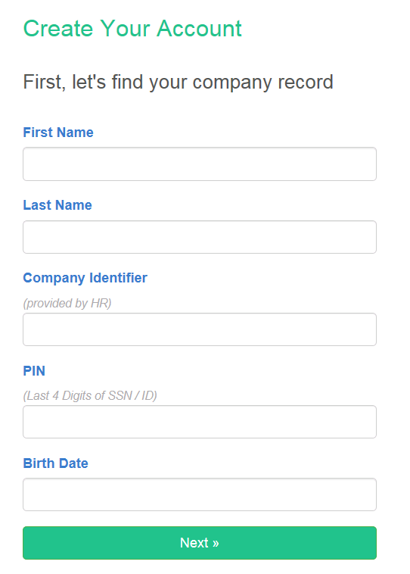
NEXT STEPS – EMPLOYEE NAVIGATOR
EVERYONE MUST LOGIN TO EMPLOYEE NAVIGATOR TO ENROLL FOR BENEFITS- INCLUDING COMPANY PAID BENEFITS
https://www.employeenavigator.com/Benefits/Login/Registration.aspx
Click on the green “Log In” button on the top right corner, then select “Register as a New User” and complete the fields noted below, using the Company Identifier – CTS2019
Click “Next”
Notes:
Lets take a look at your next steps to enroll in the benefit plans. Greiner Bio one uses a benefit administration system called Employee Navigator for benefits enrollment. Everyone must login to employee navigator to enroll for benefits- even benefits that are company paid
You will receive an email which will provide a direct link to the site where you can begin the enrollment process.

Slide 20
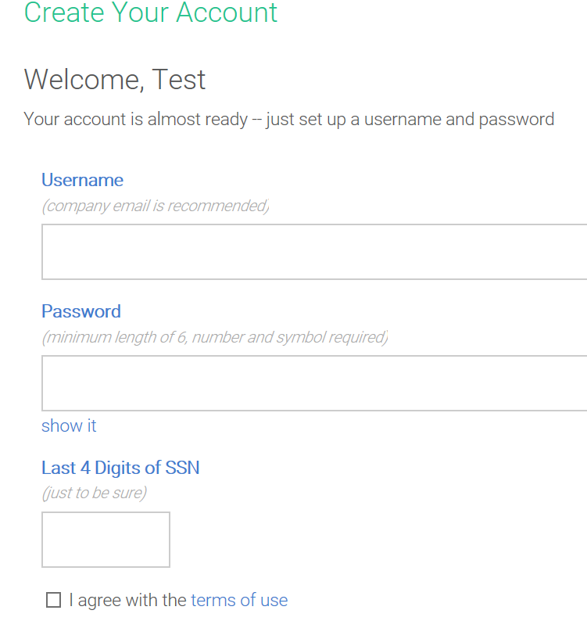
EMPLOYEE NAVIGATOR
You will then be asked to create a username and password. Please make your password something you will remember but private as this site will contain confidential employee information.
Notes:
Once you are on the site, you will be asked to create a username and password. Please make sure your password is something you will remember but keep it private – this site will contain confidential employee information.

Slide 21
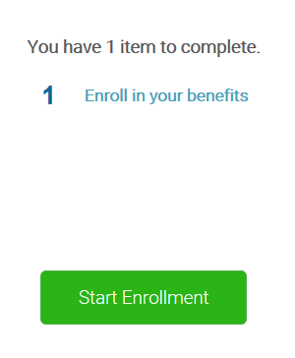
EMPLOYEE NAVIGATOR
Once you have created your login, you will be taken through a wizard that will help navigate you through the enrollment process.
You will notice a welcome greeting and a “Start Enrollment” icon as pictured below:
Complete any missing data on the first page where you will see your employee information.
Notes:
Once you have created your login, you will be taken through a wizard that will help navigate you through the enrollment process.
You will notice a welcome greeting and a “Start Enrollment” icon as pictured below.
Complete any missing data on that screen, such as your address, and click save and continue.

Slide 22
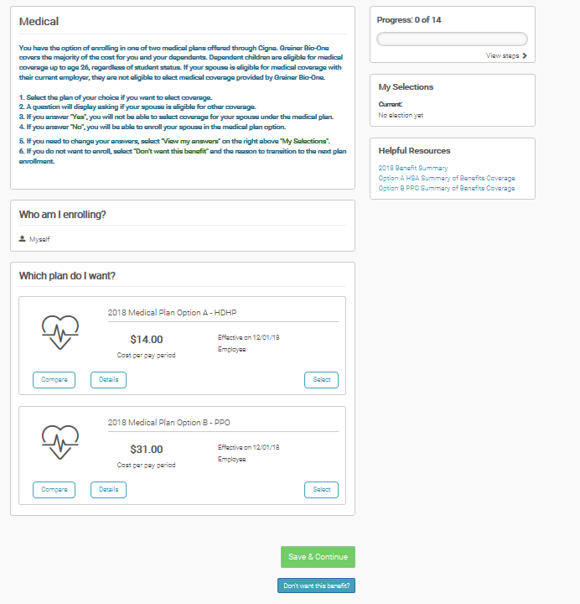
EMPLOYEE NAVIGATOR
After adding any dependents, you will now go through the enrollment process. Simply make your plan selection for each benefit:
Who am I enrolling? You will need to select your dependents on each line of coverage you are enrolling them.
Which plan do I want (if you have more than one to chose from).
You can also click on the “compare” icon to show the plan(s) and cost for all tier levels…
And the “details” icon to provide a brief benefit overview.
Click on the “Select” button which will elect your option”. Then “Save & Continue” to go to the next benefit available.
If you are not taking benefits, click “Don’t want this benefit”. It will ask you to provide a reason why you are not electing coverage.
You will do this the same for each line of coverage available to you during this enrollment process.
Notes:
After adding any dependents, you will now go through the enrollment process. Simply make your plan selection for each benefit:
Who am I enrolling? You will need to select your dependents on each line of coverage you are enrolling them.
Which plan do I want (if you have more than one to chose from).
You can also click on the “compare” icon to show the plan(s) and cost for all tier levels…
And the “details” icon to provide a brief benefit overview.
Click on the “Select” button which will elect your option”. Then “Save & Continue” to go to the next benefit available.
If you are not taking benefits, click “Don’t want this benefit”. It will ask you to provide a reason why you are not electing coverage.

Slide 23
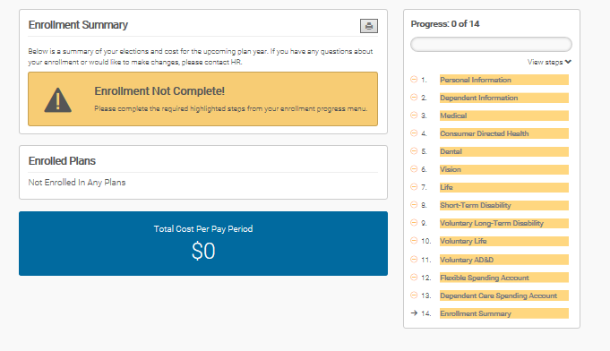
EMPLOYEE NAVIGATOR
You can follow the progress bar located on the right if you need to go back to any benefit. If you miss any elections or do not complete a section, when you get to the end, it will reflect “Enrollment Not Complete!” banner and highlight the benefit line you missed. Please click on the benefit, make your election, and then click “Enrollment Summary” to complete your enrollment process. If you do not click “Agree” at the end of the process, your benefits will not update.
To modify or go back, simply click on the benefit you want to modify/change. Be sure to always select “SAVE & CONTINUE” for any modifications that you make.
You can enroll from a computer, laptop, or tablet!!
Notes:
You can follow the progress bar located on the right if you need to go back to any benefit. If you miss any elections or do not complete a section, when you get to the end, it will reflect “Enrollment Not Complete!” banner and highlight the benefit line you missed. Please click on the benefit, make your election, and then click “Enrollment Summary” to complete your enrollment process. If you do not click “Agree” at the end of the process, your benefits will not update. Please make sure you click agree when you are finished so we can get you enrolled!

Slide 24
IMPORTANT DATES & RESOURCES
Open Enrollment is May 15, 2019 to May 21, 2019 at 1PM
Elections become effective June 1, 2019
If you need to make changes to your existing Voluntary Life, AD&D or Critical Illness coverage please see Human Resources.
Questions?
Chastity Strickland
(910) 892-0027
Refer to your benefit guide for additional details
Notes:
Thank you for watching this presentation. Please make sure to turn in all of your decisions by the end of Open Enrollment to ensure you are enrolled in the plans that you want.
Please contact us with any questions you have. You can also find additional detail in your benefit guide.

Slide 25
Thank You for Being a Part of the Carolina Therapy Services Team Our employees are our greatest asset and we are proud to offer benefits to support and protect the health and wellbeing of you and your family
Notes:
Thank you for being part of our team. We know that our employees are our greatest asset and we are proud to offer a benefit program to support and protect the health and wellbeing of you and your family.

